Slide 1
Loan Status Prediction
Aryan Abhijit Kulkarni

Slide 2
Step-1 Importing Required Libraries
Numpy- For numerical operations
Pandas- For handling and manipulation of datasets
Matplotlib- For data visualization
Seaborn – It is also a visualization library like matplotlib where more interactive and statistical models are made using this library.
Sklearn (Sci-Kit learn) – It is a Machine Learning framework from where we will import specific algorithms.

Slide 3
Sklearn or Scikit learn framework is basically used for building Machine learning models.
In this project I imported Logistic Regression model first as I was going to build that model first.
Then after that we need to also import StandardScaler, for improvising model performance.
Then VIF which stands for variance_inflation_factor which checks the relation between each feature with the label.
Then also import accuracy_score, confusion matrix, roc_auc_curve to plot curves.

Slide 4
STEP-2 Loading and cleaning Dataset
Then after importing libraries load the dataset.
Fill the null/missing values in the dataset. Fill the missing values with mean, median, mode according to the nature of features.
Remove the the unnecessary values from the dataset.
Outliers are the values that act as a noise in the dataset.
Encoded the categorical values to numerical values through grade mapping.
Remove unnecessary columns that are not required for prediction.

Slide 5
Step-3 Data Visualization
Plotted a graph of each feature to check its nature and density.
Then by removing the label column plot a box-plot graph to checked whether there are any outliers.
Detected some outliers in specific columns.

Slide 6
Step-4 removing the outliers
There is a method for removing the outliers. That is interquartile range
Formula- Q1 = The 25th percentile (lower quartile) of the data.
Q3 = The 75th percentile (upper quartile) of the data.
IQR = Q3 – Q1
By the help of this formula removed outliers from each columns where outliers were present.
Lower Bound=Q1−1.5×IQR
Upper Bound=Q3+1.5×IQR

Slide 7
Step-5 Data visualization & Multicollinearity
After removing the outliers check the changes in the graph again after the outliers have been removed.
You will see a normalised graph than before.
By the help of VIF check for multicollinearity of the features.
High multicollinearity values gives incorrect prediction results.

Slide 8
Step-6 Model building and Evaluation
Split the dataset into training and testing data.
Then train the model (x_train, y_train)
Then print the scores Training = 81.9% Testing = 84.6%
Print the classification Report where distribution of scores is visible
In case the model is overfitted or underfitted we perform evaluation.
K-fold Cross validation and Hyperparameter tuning.

Slide 9
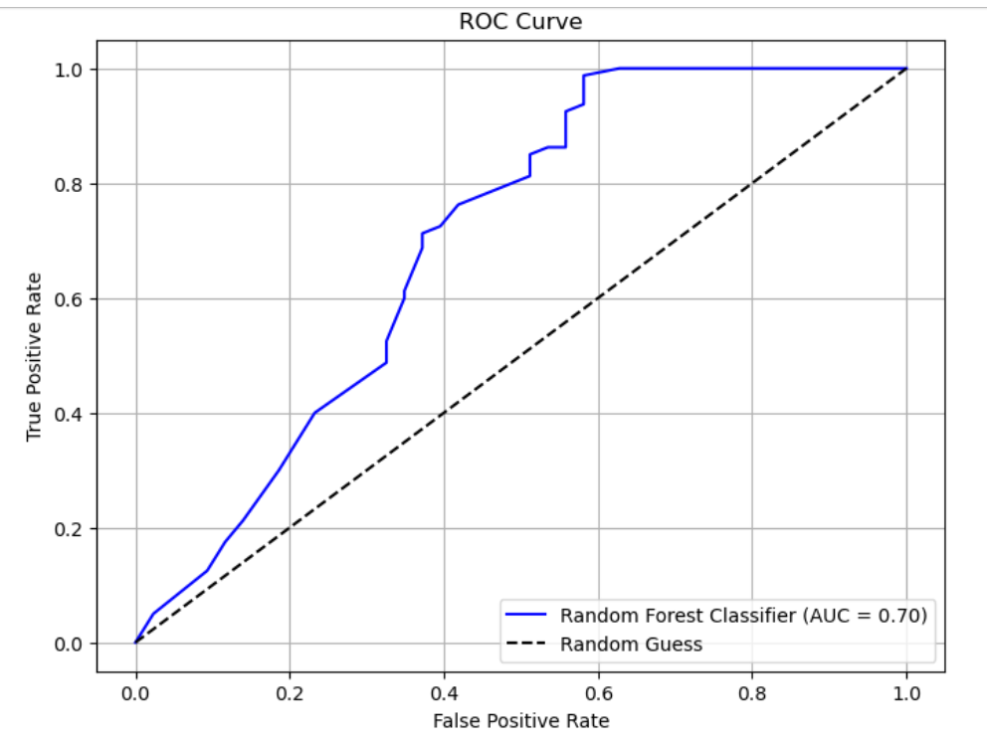
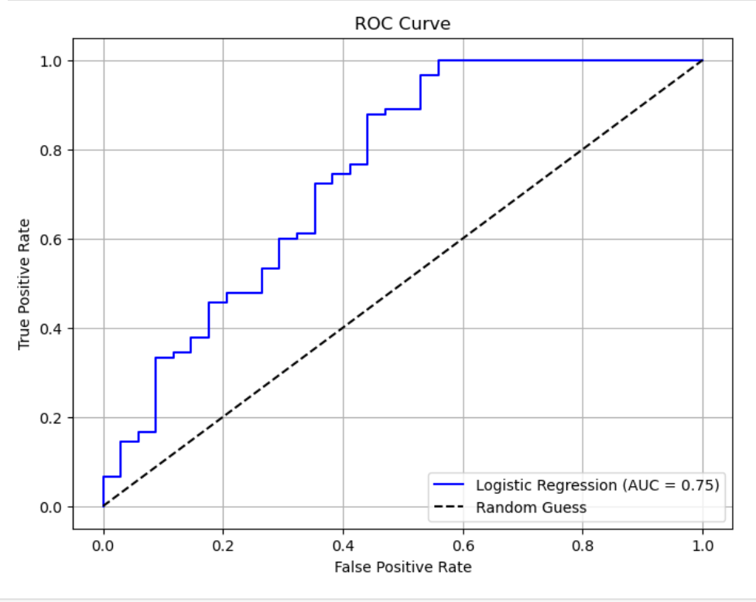
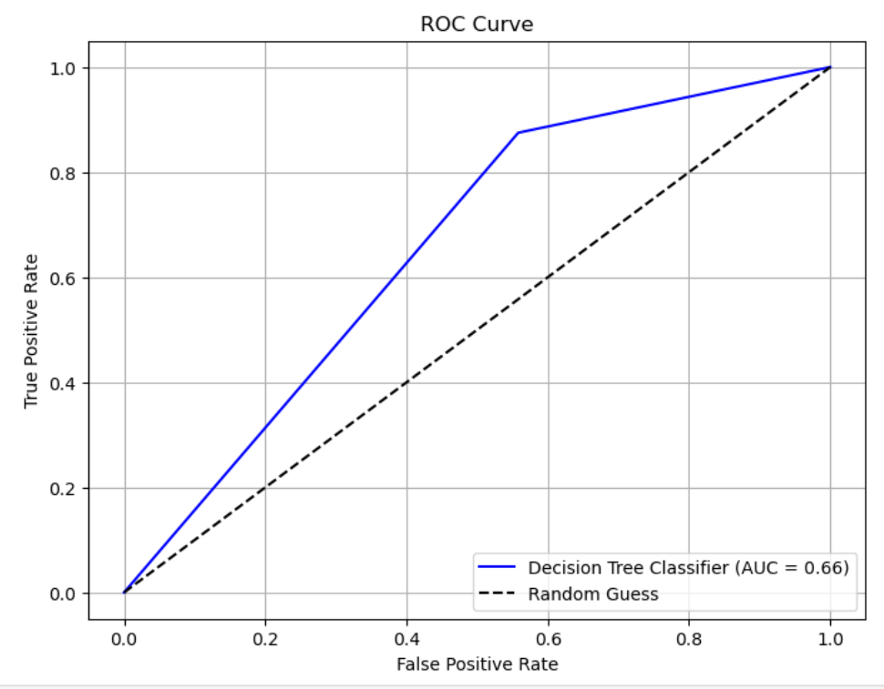
STEP-7 Model VisualiZation
Plot the roc_auc_curve.

Slide 10
Model Summary
Logistic Regression – Evaluation Score = 79%, AUC-Score = 0.75
Decision Tree Classifier – Evaluation Score = 80%, AUC-Score = 0.66
Random Forest Classifier – Evalaution Score = 80.48%, AUC-Score = 0.70
Hence the Random Forest Classifier Model is best fit.
Then save the Training model of evaluation in a pickle file.

